Slide 1

Española campus cover

Slide 2
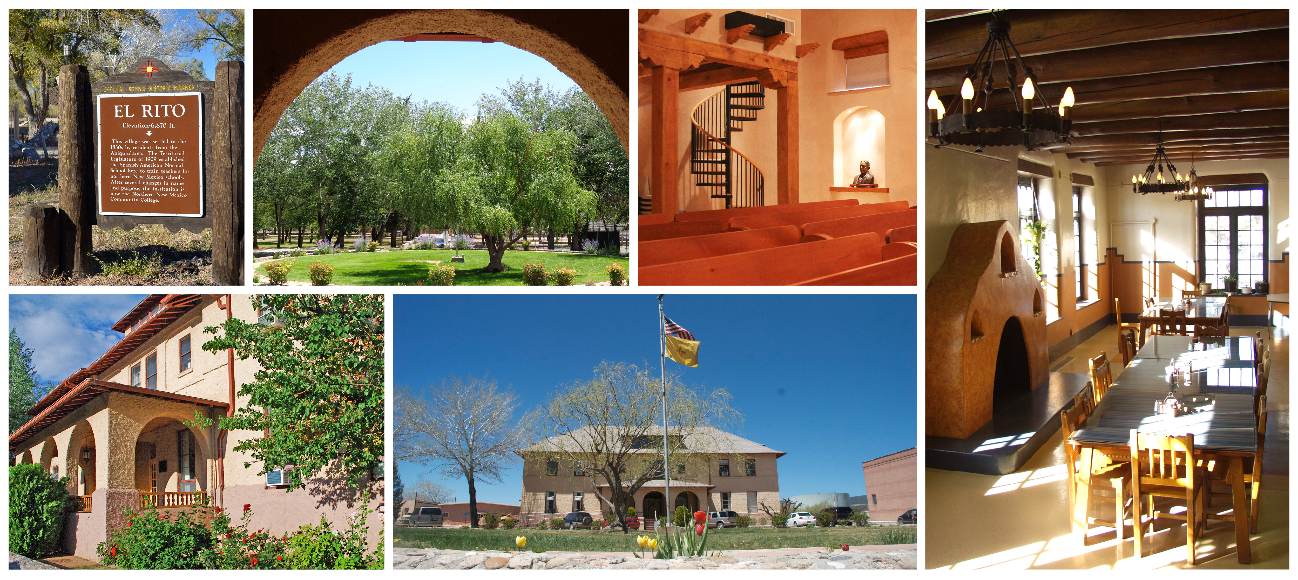

El Rito campus cover

Slide 3
48 pt Alt Cover or
Section head (1.5)
Picture here
Subhead here

Slide 4
48 pt Alt Cover or Section head (1.5)
Subhead here
4

Slide 5
44 pt Calibri light Headline at 2.38
This is a simple basic branded slide design (32pt, at 1.38)
Line spacing 1.0/0, .25” left, hanging .25” space bf 6 pt .
To duplicate this slide: Com-shift-D, or select
“Duplicate slide” from “Insert” menu.
Another bullet point
Stop here! Go to another slide if you have more text.
Emphasize teaching and lab facilities.
Evaluate and assess current status of buildings.
Review additional needs for providing high-quality programs
Estimate budget required for each stage.

Slide 6
44 pt Calibri light Headline at 2.38
This is a simple basic branded two column slide design (28pt, at 1.38)
Line spacing 1.0/0, .25” left, hanging .25” space bf 6 pt .
Another bullet point
Stop here!
Line spacing 1.0/0, .25” left, hanging .25” space bf 6 pt .
To duplicate this slide: Com-shift-D, or select “Duplicate slide” from “Insert” menu.
Another bullet point
Stop here!
Emphasize teaching and lab facilities.
Evaluate and assess current status of buildings.
Review additional needs for providing high-quality programs
Estimate budget required for each stage.

Slide 7
44 pt Calibri light Head at 2.38
Picture here
Basic slide design (32pt, at 1.38)
Line spacing 1.0/0, .25” left,
hanging .25” space bf 6 pt .
To duplicate this slide: Com-shift-D, or select
“Duplicate slide” from “Insert” menu.
Another bullet point. Stop here
Emphasize teaching and lab facilities.
Evaluate and assess current status of buildings.
Review additional needs for providing high-quality programs
Estimate budget required for each stage.

Slide 8
44 pt Calibri light Headline at 2.38
Picture here
This is a simple basic branded slide design (28pt, at 1.38)
Line spacing 1.0/0, .25” left, hanging .25” space bf 6pt .
Another bullet point
Stop here! Go to another slide if you have more text.
Emphasize teaching and lab facilities.
Evaluate and assess current status of buildings.
Review additional needs for providing high-quality programs
Estimate budget required for each stage.

Slide 9

44 pt Calibri light Headline at 2.38
Bullet one – Content here
Bullet Two – Content here
Bullet Three – Content here
Bullet Four – Content here
Bullet Five – Content here

Slide 10
Q & A with the Presenters
Thank you for joining us today!
10

